Slide 1
Configuration file handler

Slide 2
This application was created from the need to manipulate the contents of several files
these files are configuration files for software tests and
they are written in txt format

Slide 3
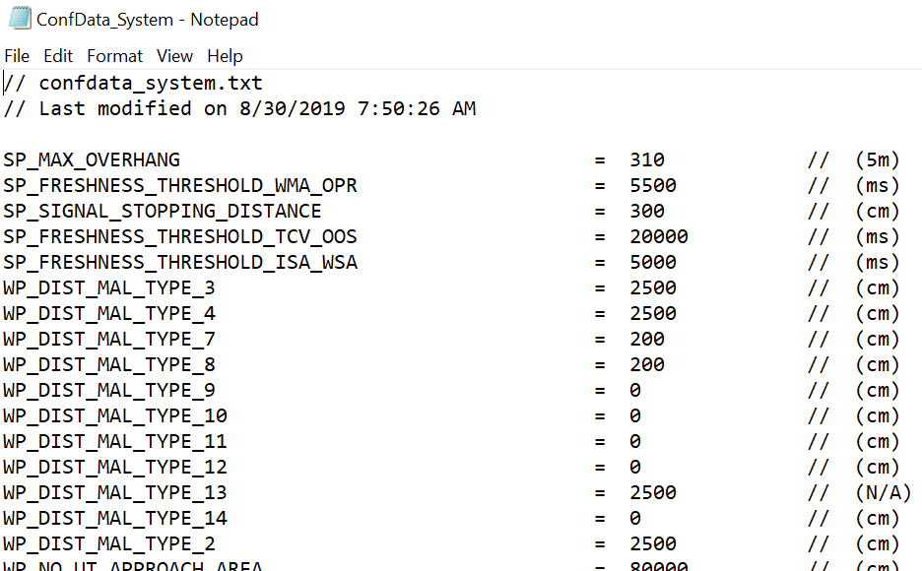
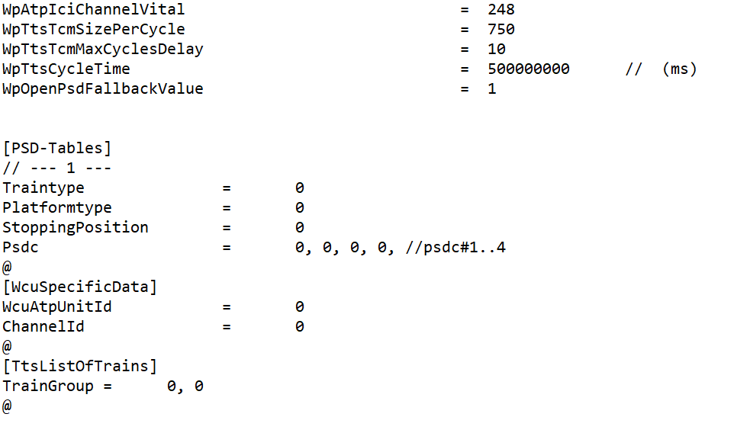
Confdata_system and Confdata_wcu
ConfData_system
Confdata_wcu
And this one contains some parameters, but in addition we have several parameter structures
It contains certain parameters with a specific value and unit

Slide 4
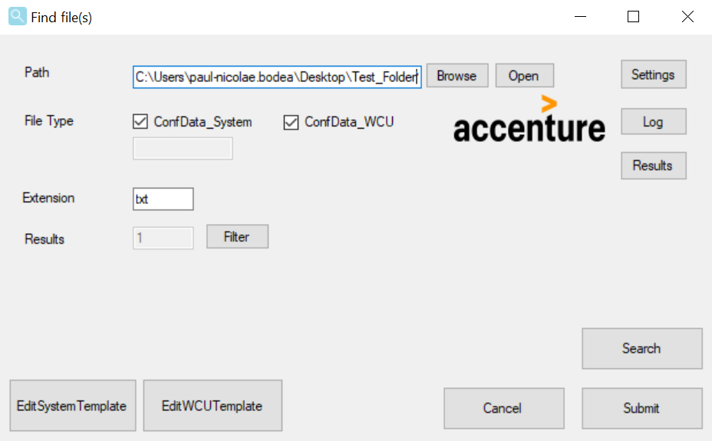
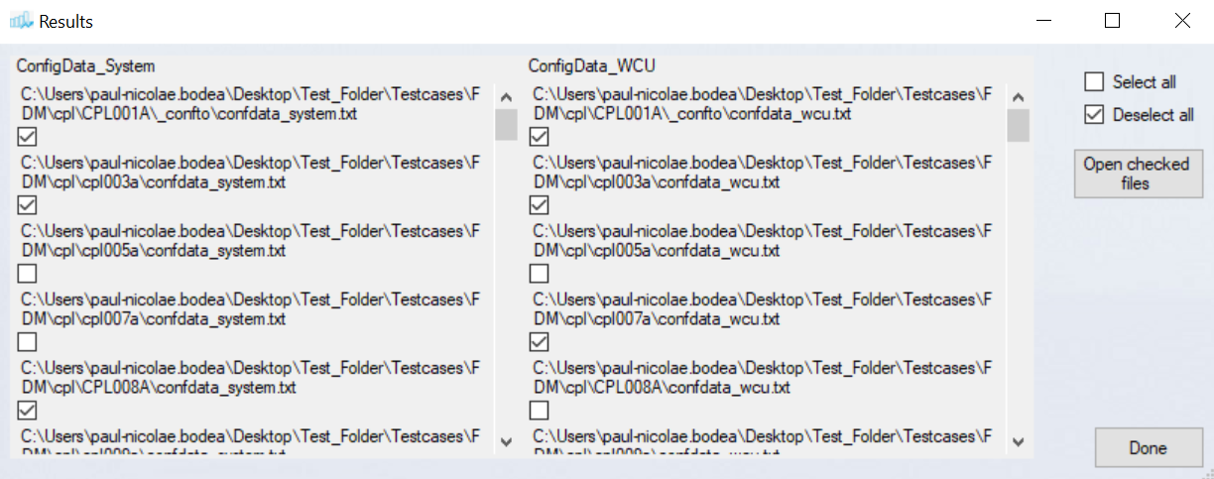
the application
Search for all WCU or System files in a folder and subfolders. The folder can be selected by the user
If the user wishes he can filter the files that will be processed by pressing the filter button

Slide 5
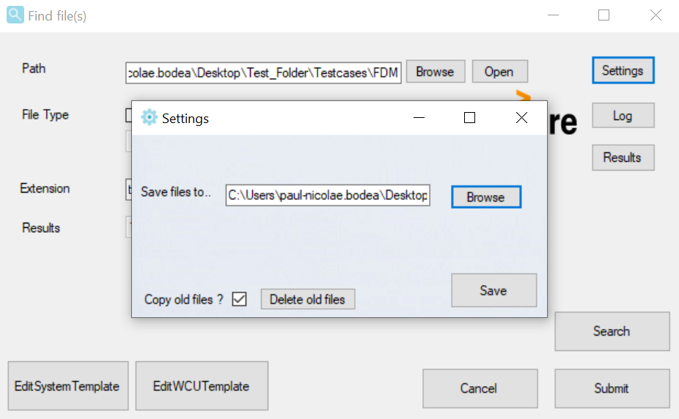
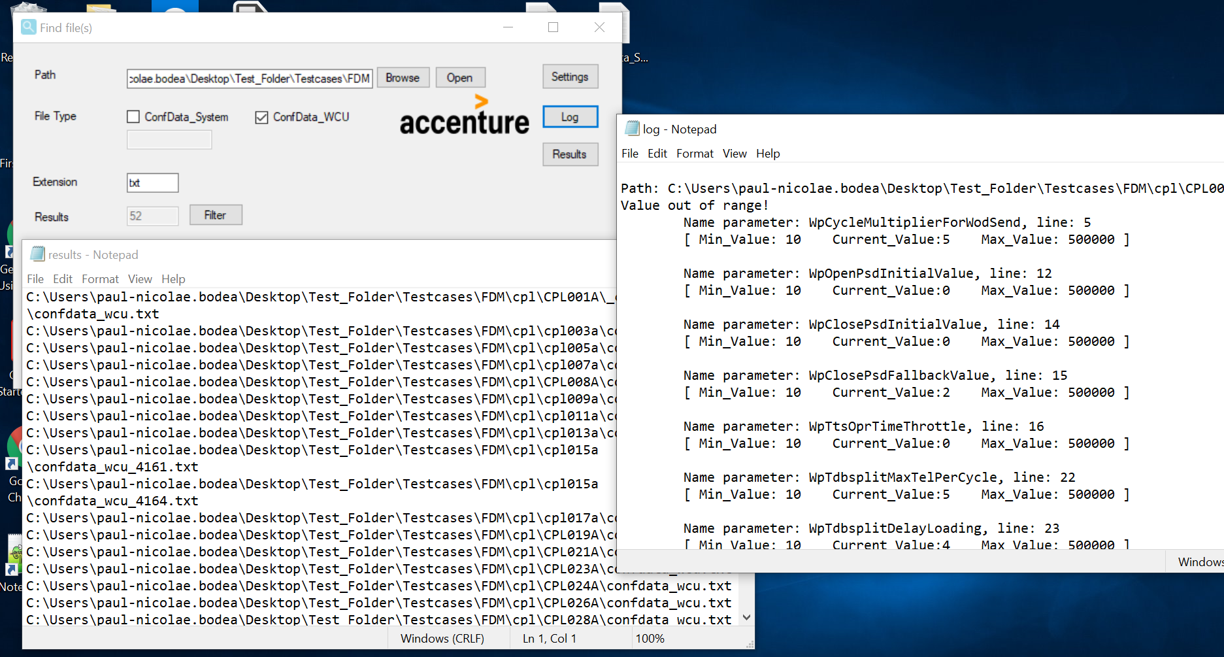
Settings button
The settings button opens a new window where you can set the destination of the log and results files and if the files are saved before editing
.
Log and Results button
The log button opens the file that contains warnings about the parameters
The results button opens the file that contains all the paths of the files for which you want to modify

Slide 6
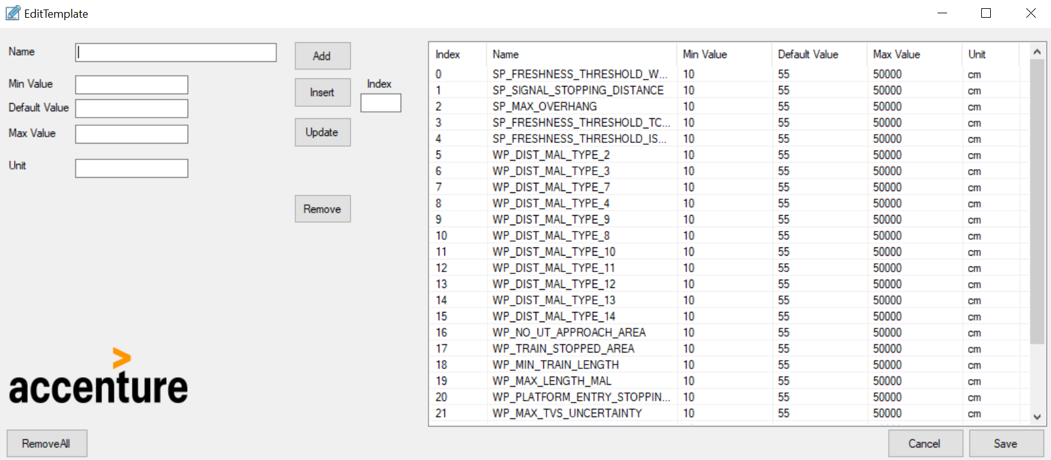
There are two templates for wcu and System with all possible parameters
Each parameter in the template has a default value, a minimum value, a maximum value, and unit
In templates you can reorder with drag and drop, add, insert, delete and edit parameters

Slide 7
When the submit button is pressed the application does the following for all the selected files
Insert parameters
If parameters in the template do not exist in the file, the application inserts parameters from template with default value
reorder parameters
reorders parameters by template
Delete parameters
Delete duplicate parameters from the file
Warn the user
Alerts the user in the Log if there are parameters in files outside the range between the minimum value and the maximum value and if there were duplicates that he deleted

Slide 8
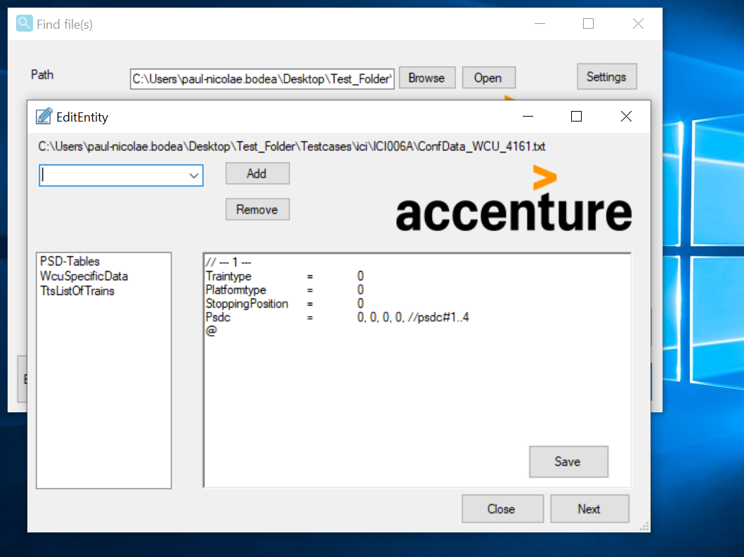
The end parameters of the wcu file need to be changed more often. For each selected wcu file, a new window with parameters of this type opens.
In this window the user can:
Add new parameter structures
Remove parameter structures
Reorder parameter structures
Edit parameter structures

Slide 9
Next I will present you a small test

